Slide 1
Houses in dallas-fortworth metropolitan area
By khoa truong
Supervised by dr. hamm

Slide 2
Motivation For this capstone project
The Financial market has been a hot topic since 2021due to extreme votality that has never been seen before.
A single-family house price can be $450K in June and then just dropped to $399K in August.
This ends up with people don’t know what would be the right time that they can invest or simply buy on for living.
Can we create a unique ML model that solve this problem?

Slide 3
Milestones this semester
Extract information from Zillow monthly and curated the datasets.
Use statistics and unsupervised learning techniques to analyze the features in the dataset.
Create a regression model that predict prices based on monthly prices.

Slide 4


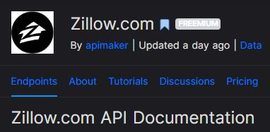
Extraction and curation
We use Zillow.com API (on RapidAPI) to get the data.
This is the step that took months to be done.
Reasons:
+ Have to understand and learn how to use API.
+ The descriptions are out of the place. Some providers don’t list the features of the house carefully.

Slide 5
Features in the dataset
Category features: Zipcode, City, County, SchoolDistrict, hasGarage, etc…
Numerical features: living Area square feet, bedrooms, longitude, latitude, bathrooms, monthly Home Owner Association Fee,…
There are around 215 to 225 features in total after One-Hot encoding.
Fluctuation in Features: Some Category features in one month have more categories than in the other month.

Slide 6
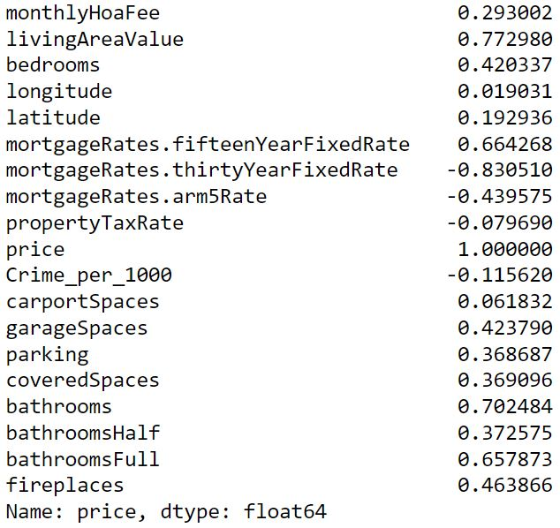
Numerical features vs price (September)

Slide 7
Binary categorical features
We will use box plots and other descriptive statistics to understand the distribution of prices better.
Metrics: Mean, standard deviation, median, mode, skewness, kurtosis.
Skewness: How long/short the tail of the distribution is.
Kurtosis: How fat/thin the tail of the distribution is.

Slide 8
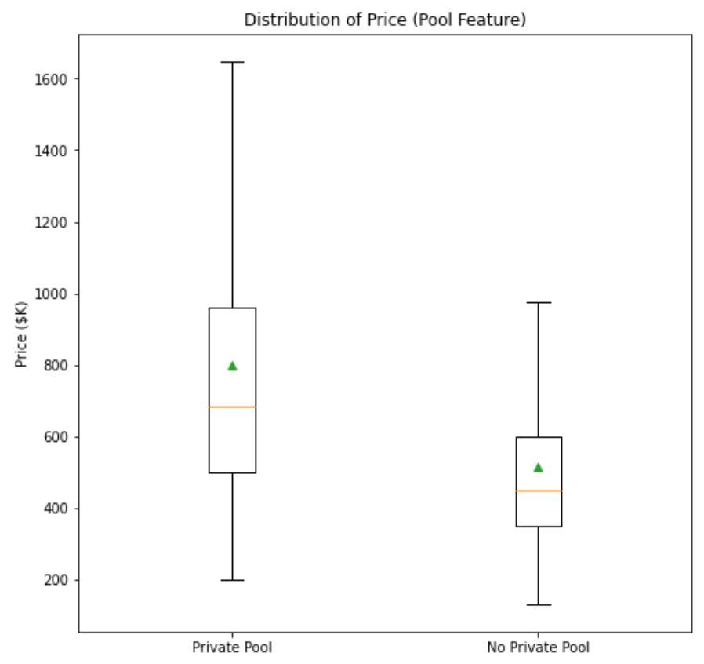
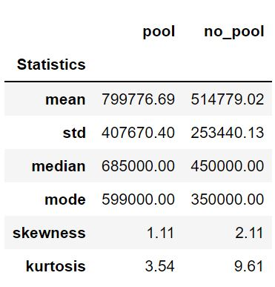
Pool feature (Outliers are not shown)

Slide 9
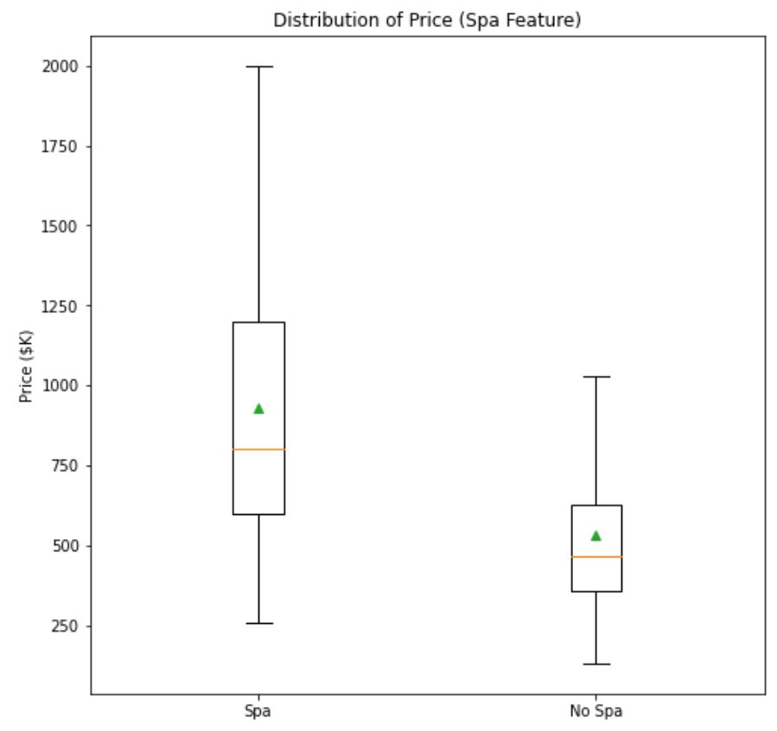
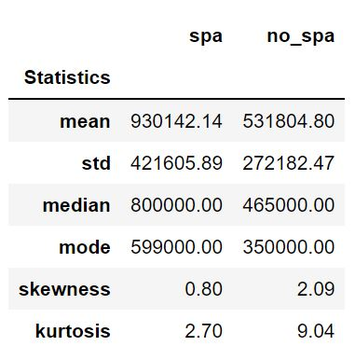
SPA FEATURE (Outliers are not shown)

Slide 10
Non-binary categorical features
We will only use box plots to investigate the price distribution.
Too many features due to one-hot encoding.

Slide 11
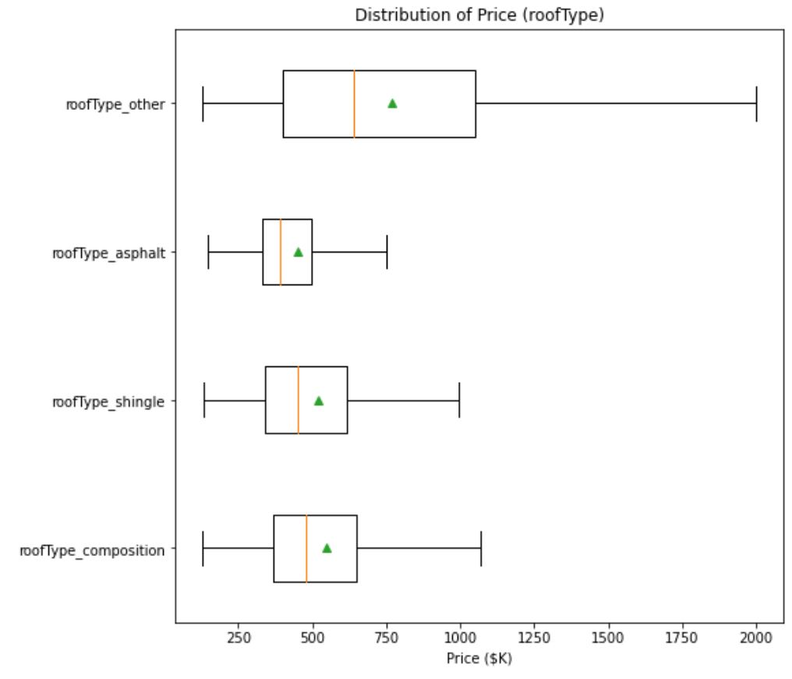
Rooftype

Slide 12
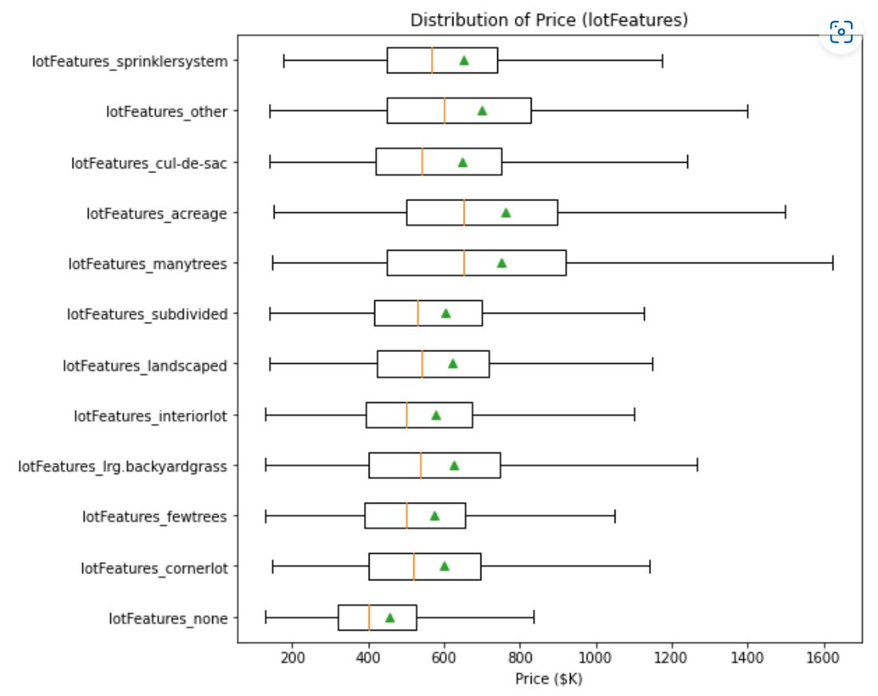
Lot features

Slide 13
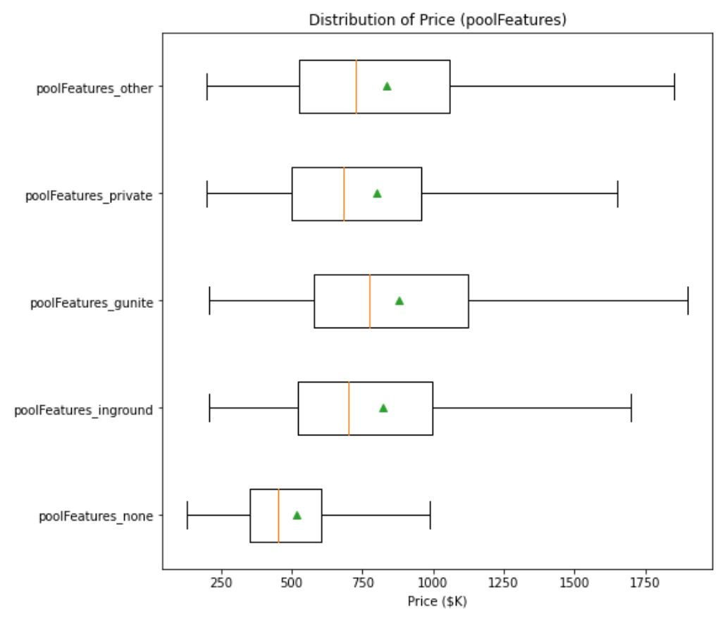
Pool features (parts of the pool)

Slide 14
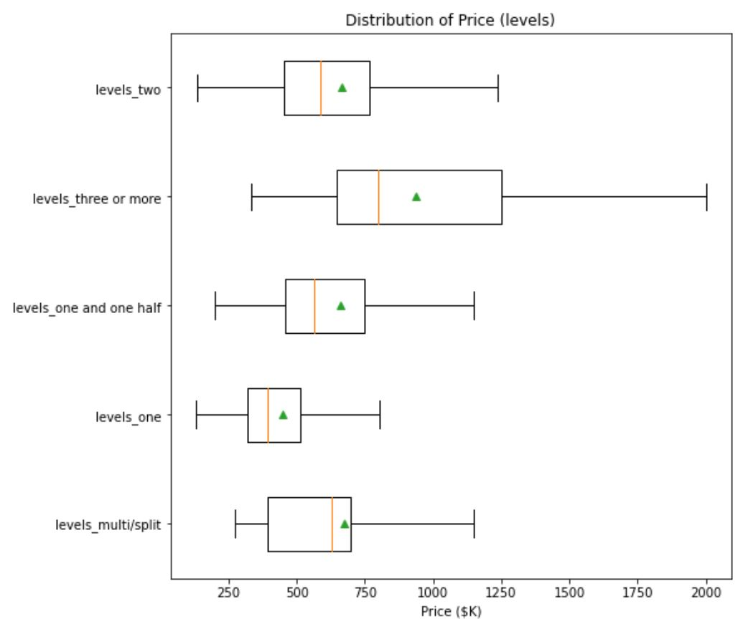
Levels

Slide 15
Why use unsupervised learning?
To visualize high-dimensional datasets.
Understand the importance of features.
Capture trends that are existed in the datasets.
First, we should scale these features into equal range from 0-1 to ensure that the bigger values features don’t dominate smaller values features.

Slide 16
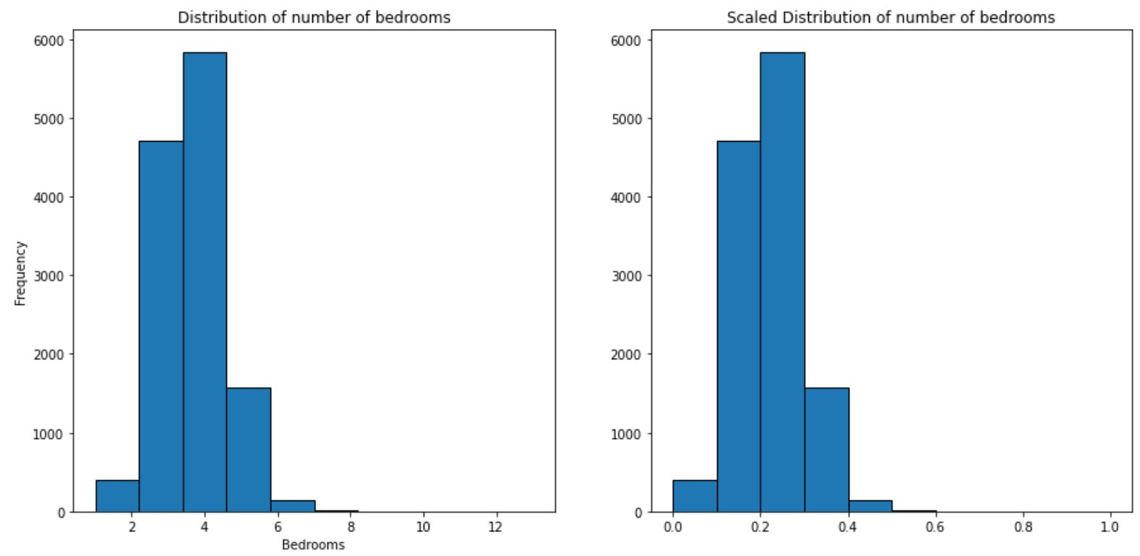
Why min max scaler? Distribution

Slide 17
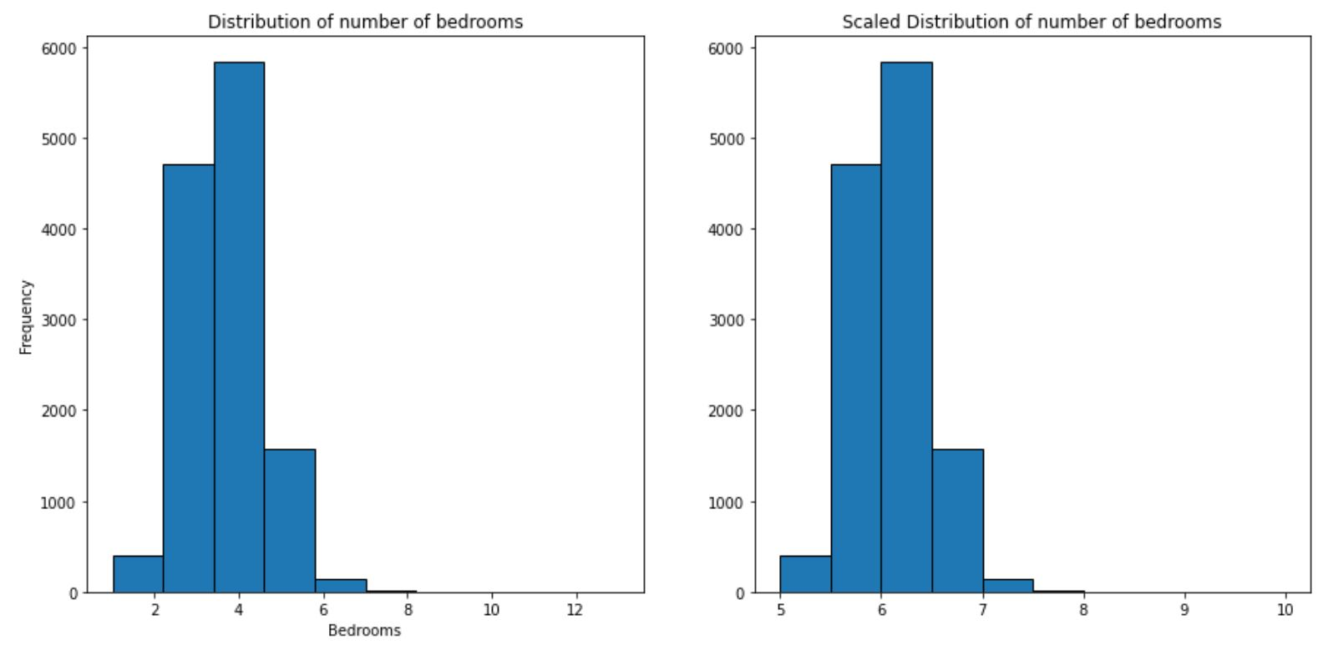
InCREASE the range (5 to 10)

Slide 18
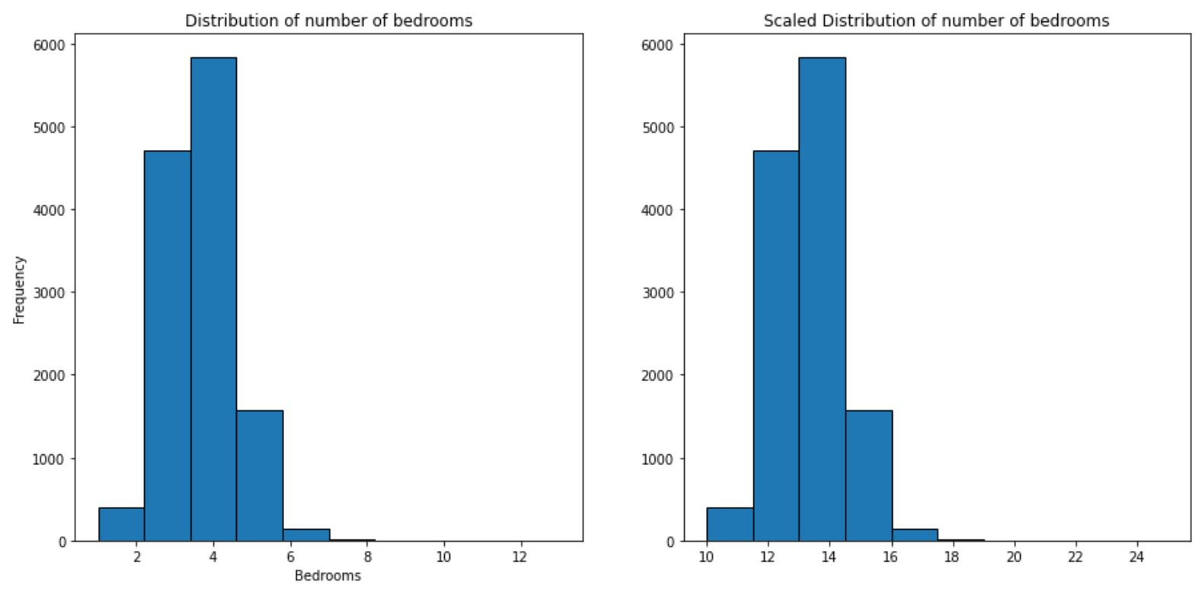
INCREASE THE RANGE (10 TO 25)

Slide 19
Different unsupervised learning techniques
Project the data on a 2D plane.
TSNE: Convert affinities of data points to probabilities and minimize the KL divergence of the Joint probabilities.
PCA: Decompose a multivariate dataset in a set of successive orthogonal components that explain a maximum amount of the variance.
Kernel PCA: Use kernels on PCA to achieve non-linear dimensionality reduction.
Spectral Embedding: Use Laplacian Eigenmaps to find a low dimensional representation of the data using a spectral decomposition of the graph Laplacian.
UMAP: Make use of some basic Riemannian geometry to bring real world data a little closer to the underlying assumptions of the topological data analysis algorithm.

Slide 20
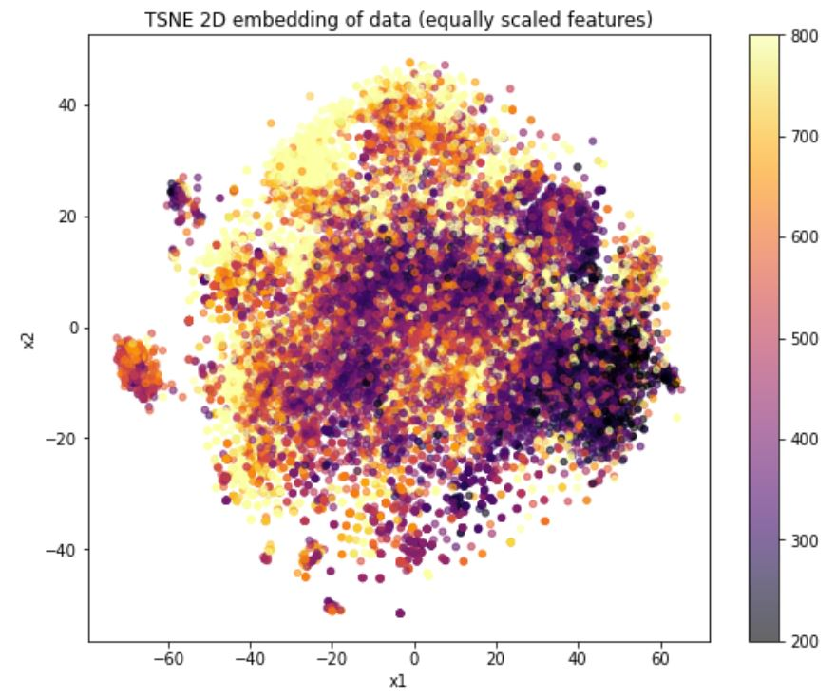
TSNE when all features stay in range 0-1

Slide 21
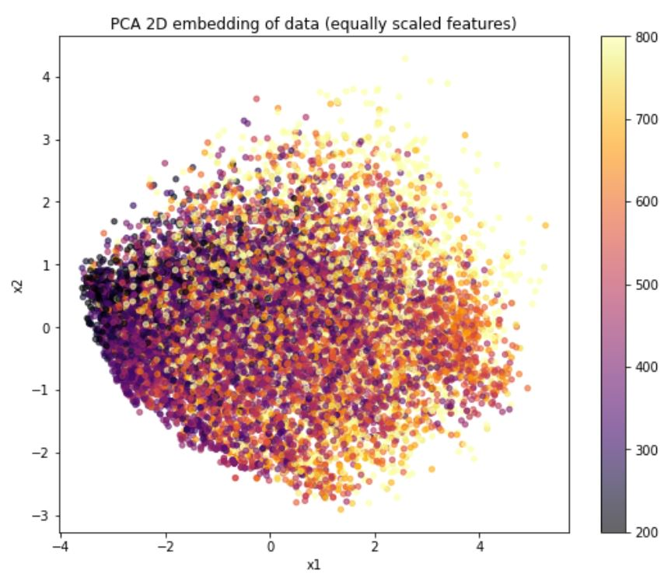
PCA WHEN ALL Features stay in range 0-1

Slide 22
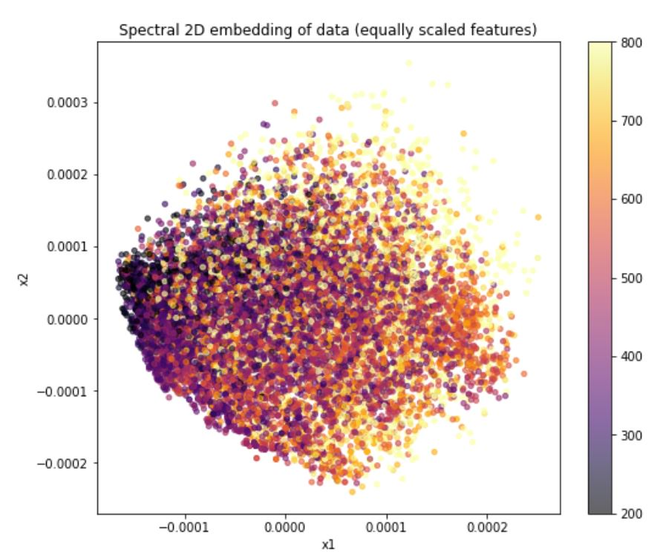
SPECTRAL WHEN ALL FEATURES STAY IN RANGE 0-1

Slide 23
What Happens if we scale more important features into a bigger range?
Important numerical features: monthlyHoaFee, livingAreaValue, bedrooms, longitude, latitude, mortgageRates.fifteenYearFixedRate, garageSpaces, parking, coveredSpaces, bathrooms, bathroomsHalf, bathroomsFull, fireplaces
These features will have bigger variances. They will be scaled with MinMaxScaler into the range 10-25.
They will also “dominate” the projections. The projections will be more influenced by these features.

Slide 24
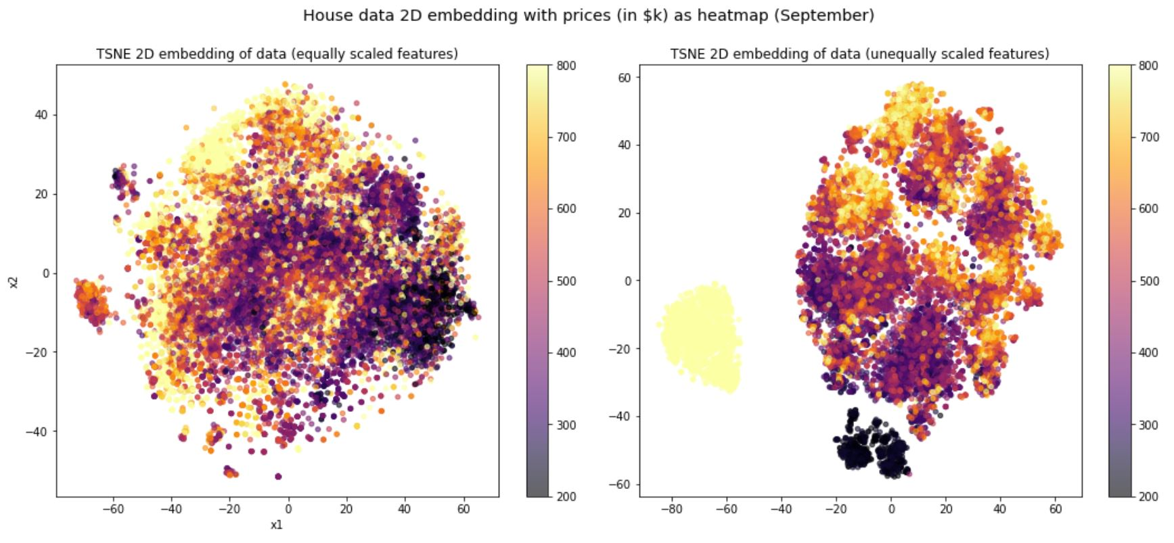
TSNE

Slide 25
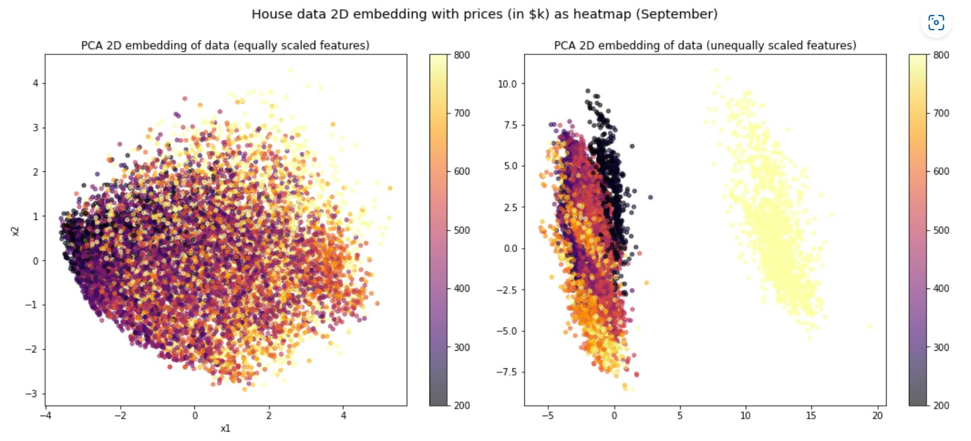
PCA

Slide 26
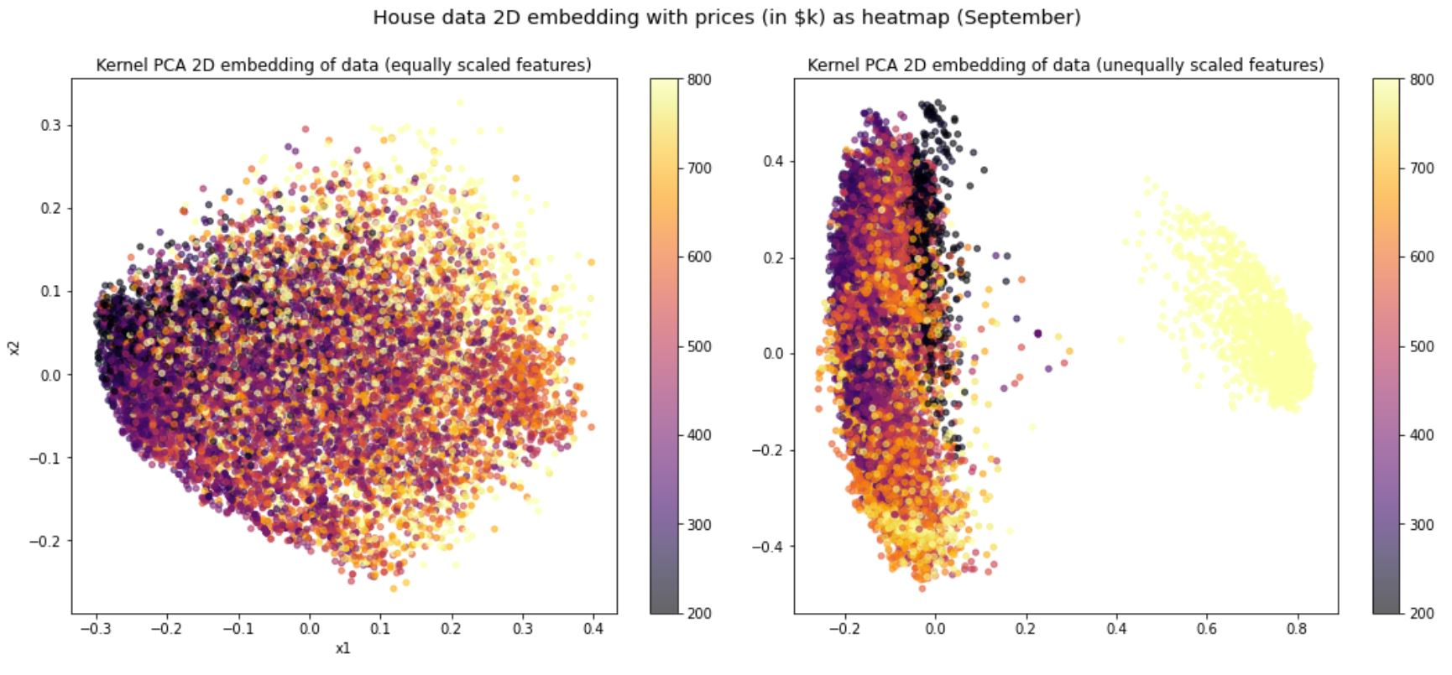
Kernel pca

Slide 27
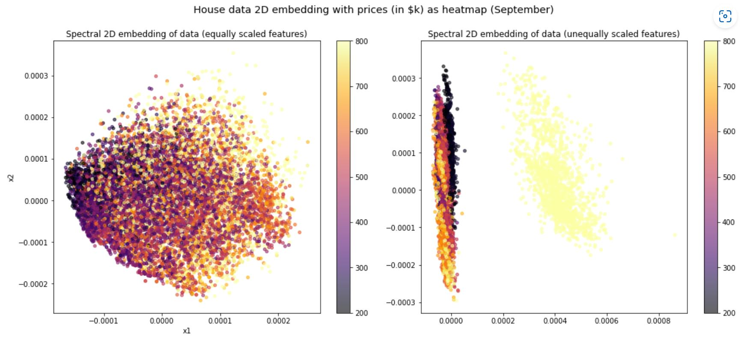
spectral

Slide 28
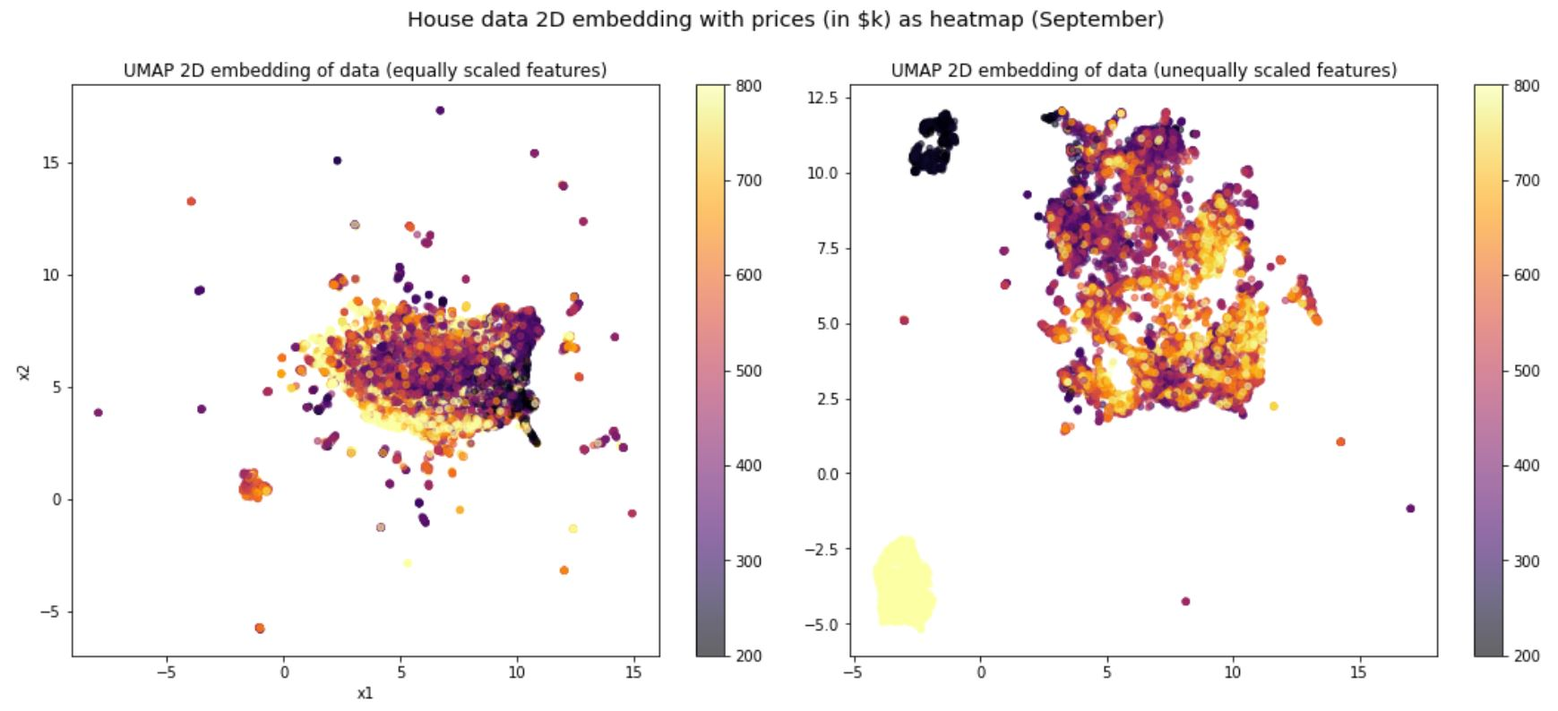
UMAP

Slide 29
HOW well the projections represent the data set?
Visually, it looks better but we need a metric to measure these data visualizations.
5-Fold cross validation with KNN (55 nearest neighbors)
Metrics: R2, RMSE, MAE
R2 higher, RMSE LOWER

Slide 30
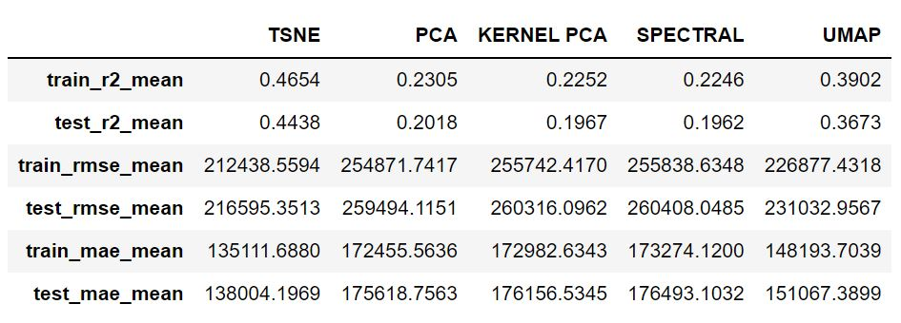
EQUAL feATURES

Slide 31
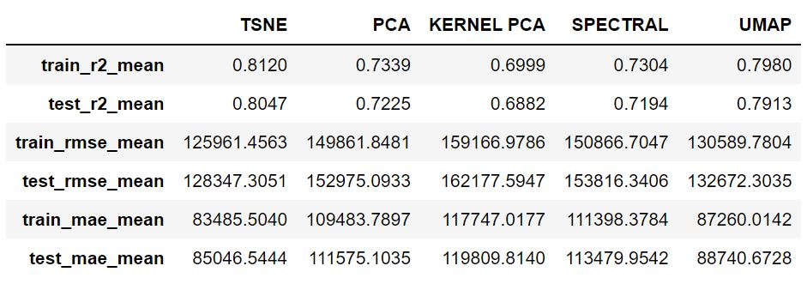
UNEQUAL FEATURES

Slide 32
Conclusions
We shouldn’t always scale all features into the range 0-1 since some numerical features are just way more important than the others.
TSNE represents the data better.
Notice: Extremely expensive houses form a different cluster.

Slide 33
Does the results stay consistent for every month?
Again, based on the results, we will unequally scale our features for the monthly datasets.
Then, we will apply the same TSNE technique and 5-Fold cross validation on all the data collected from July to November.
We will use test R2 and RMSE.

Slide 34
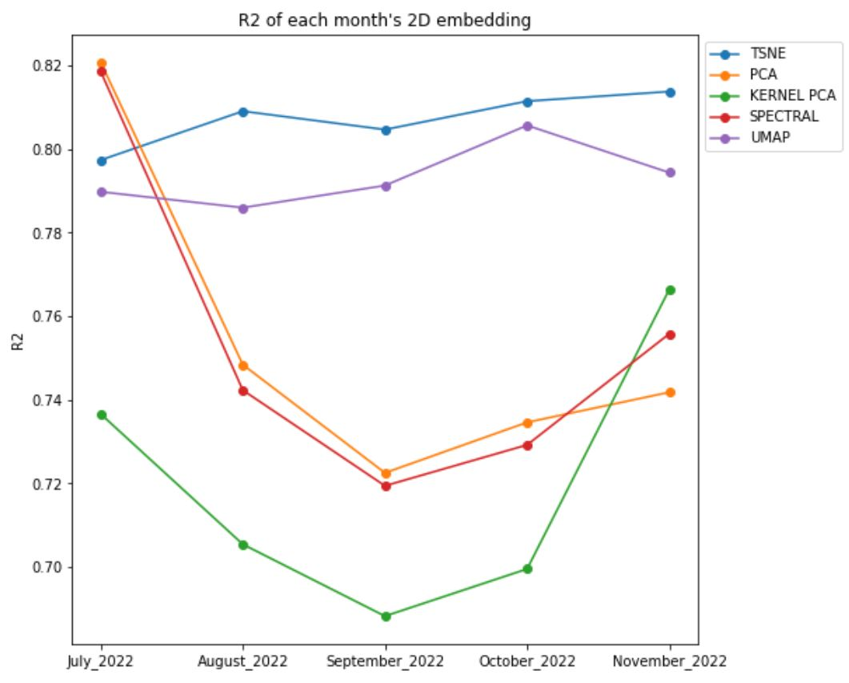
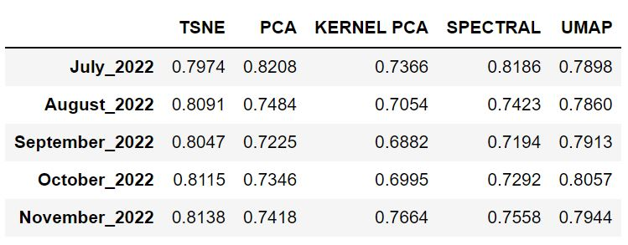
R2-score

Slide 35
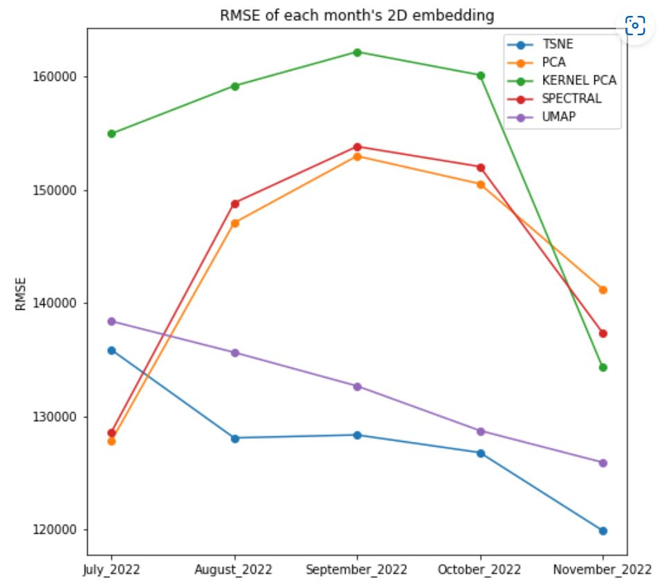
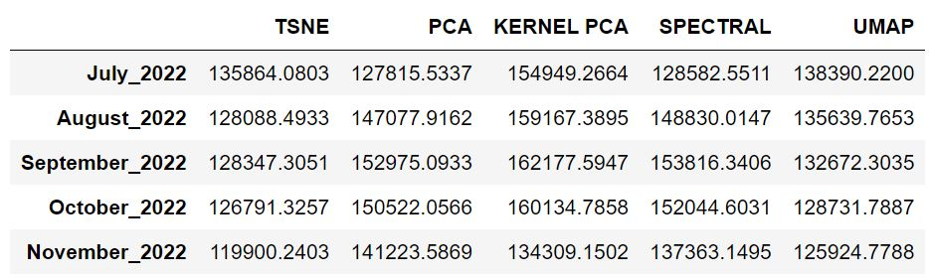
RMSE

Slide 36
Conclusions
TSNE-2D consistently represents the data very well monthly.
Unequal scale for numerical features to achieve a more desirable result.

Slide 37
PRICE PREDICTION (Supervised learning)
Use different regression techniques to predict housing prices based on monthly datasets.
Linear Regression, Decision Tree Regression, Random Forest Regression, AdaBoost Regression, HistGradientBoosting Regression.
Metrics: R2, RMSE, MAE

Slide 38
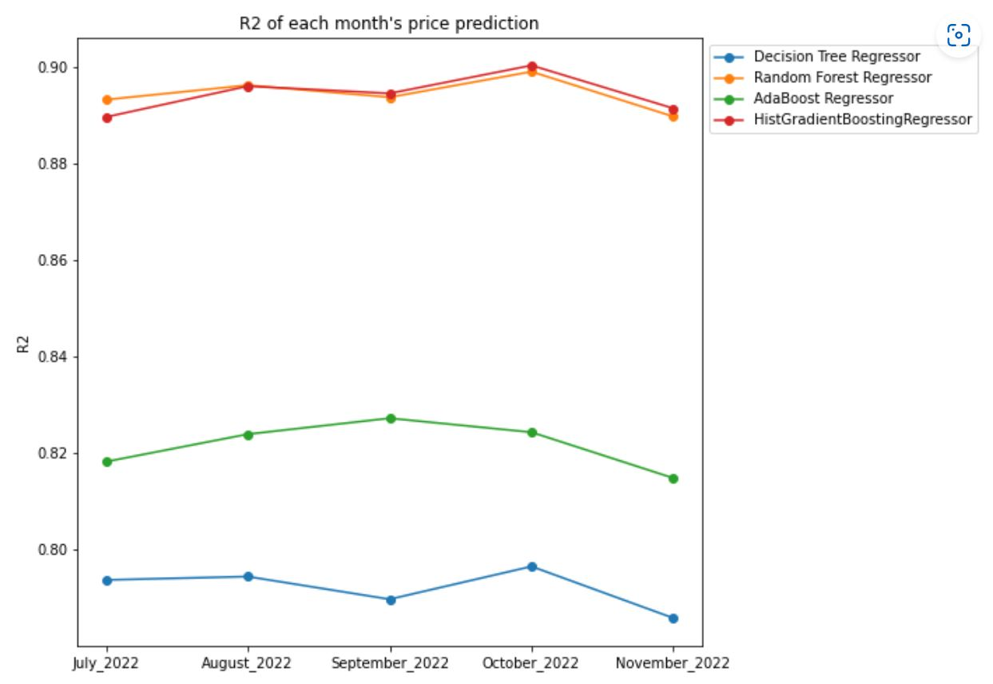
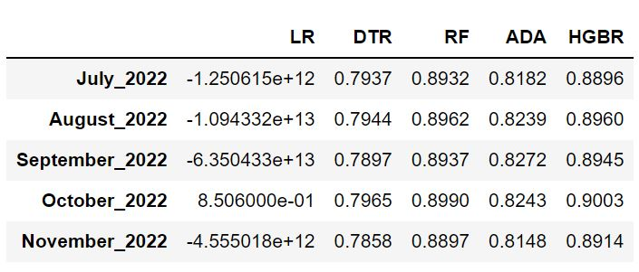
R2

Slide 39
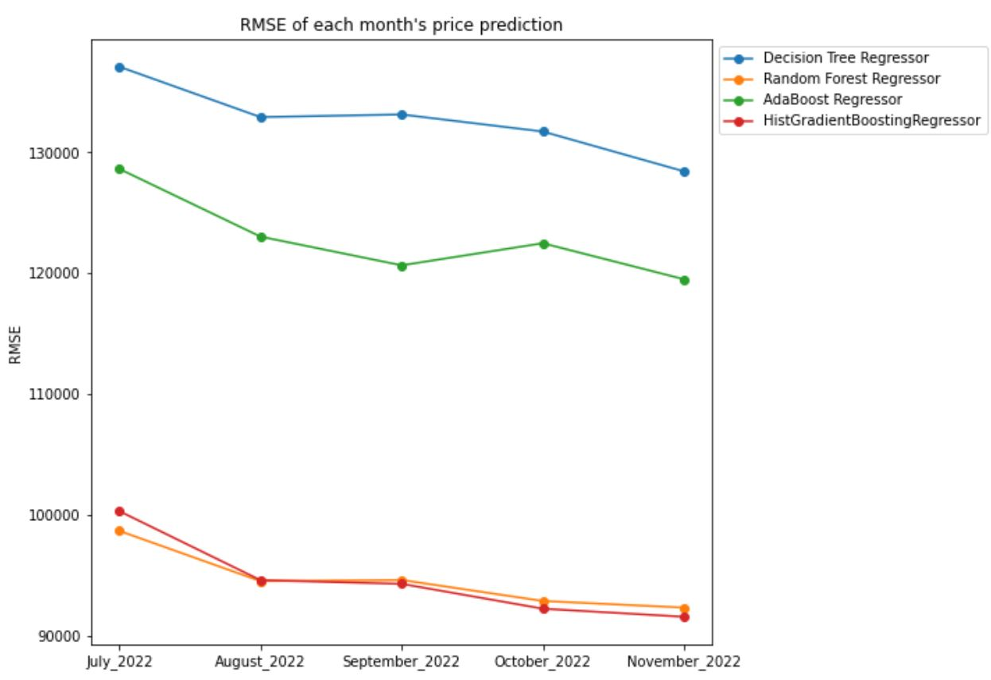
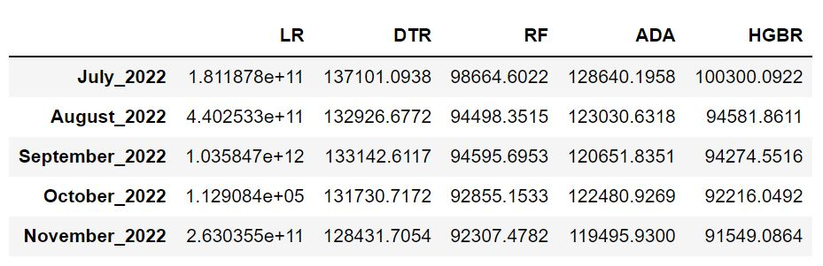
rmse

Slide 40
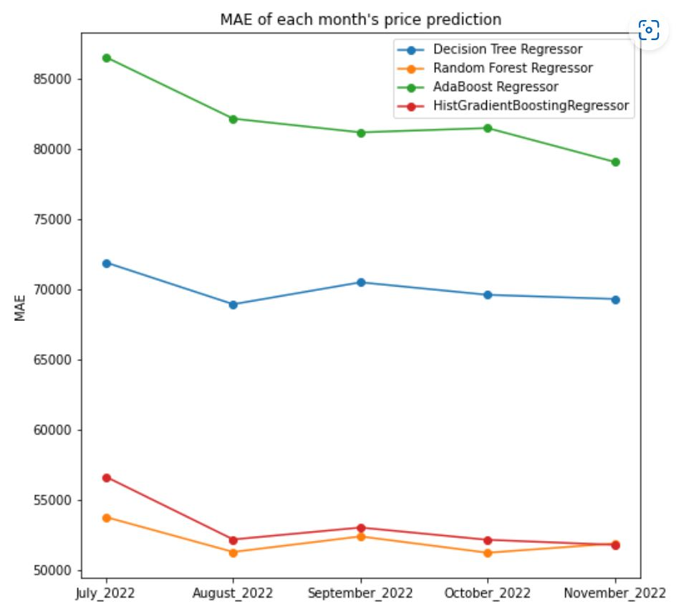
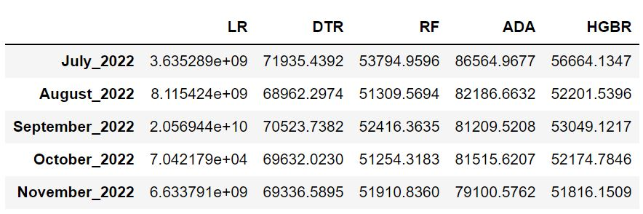
MAE

Slide 41
Conclusions
Random Forest vs. Hist Gradient Boosting.
HGB achieved better result as month goes on.
Application: We can fit monthly data into HGB and predict prices based on current price distribution.
However, the dimensions for each month dataset are different due to different category values.

Slide 42
How can we fix the issue?
Unequally scale the numerical features.
Use Kernel PCA to scale the data to 100-D with 5-Fold.
Run a Random Forest Regression on the new dataset.
We will use K-Fold again to measure the performance of the regression model.
Why not TSNE? TSNE technically is not a dimensionality reduction technique.

Slide 43
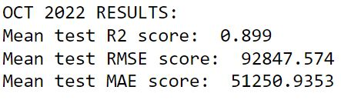
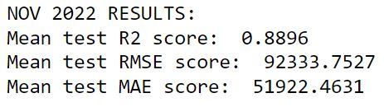
October and November results

Slide 44
Next Semester
Time Series Analysis for housing prices:
+ Understand the housing prices timeline (past-present-future).
+ Forecast the housing prices distribution in the future.

Slide 45
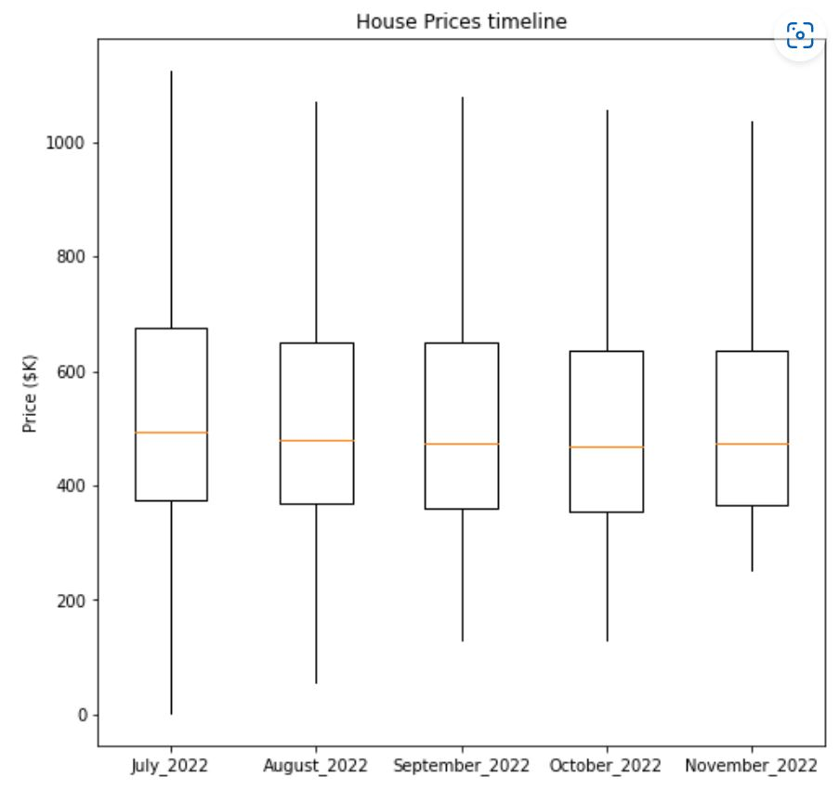
Price timeline

Slide 46
Software use
Python 3.8
Libraries: Matplotlib, Pandas, Sklearn, Seaborn.

